Slide 1

Radiomics – UkBiobank

Slide 2
Hand crafted radiomics
In the following slides we show the results extracted from the Jupyter Notebooks

Slide 3
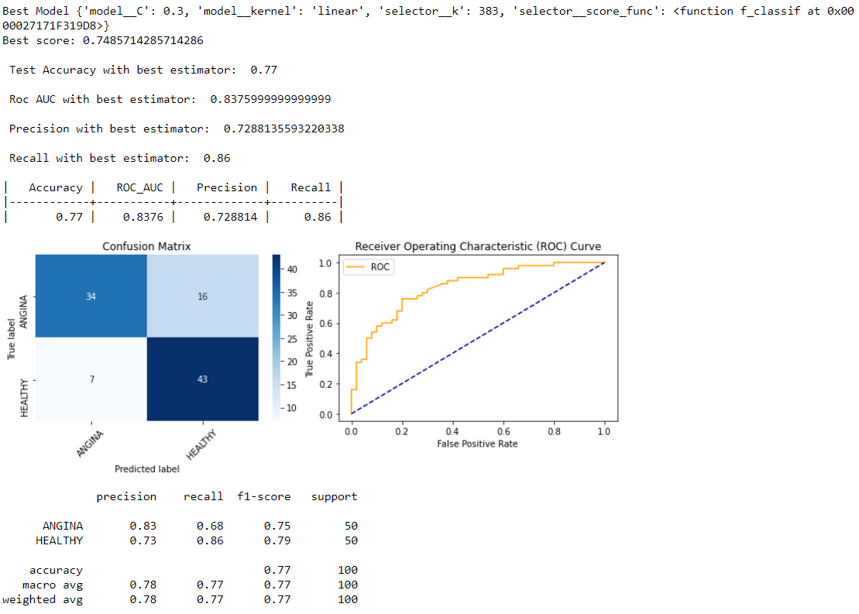
Larger dataset (12-8) ANGINA

Slide 4
Angina cont

Slide 5
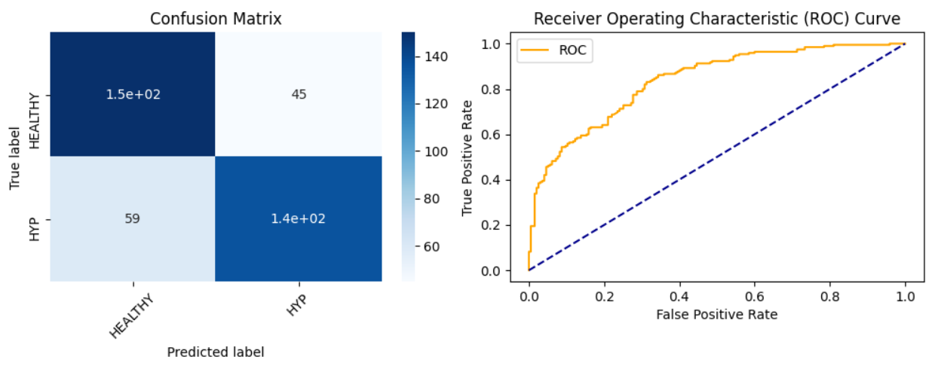
HYPERTHENSION

Slide 6
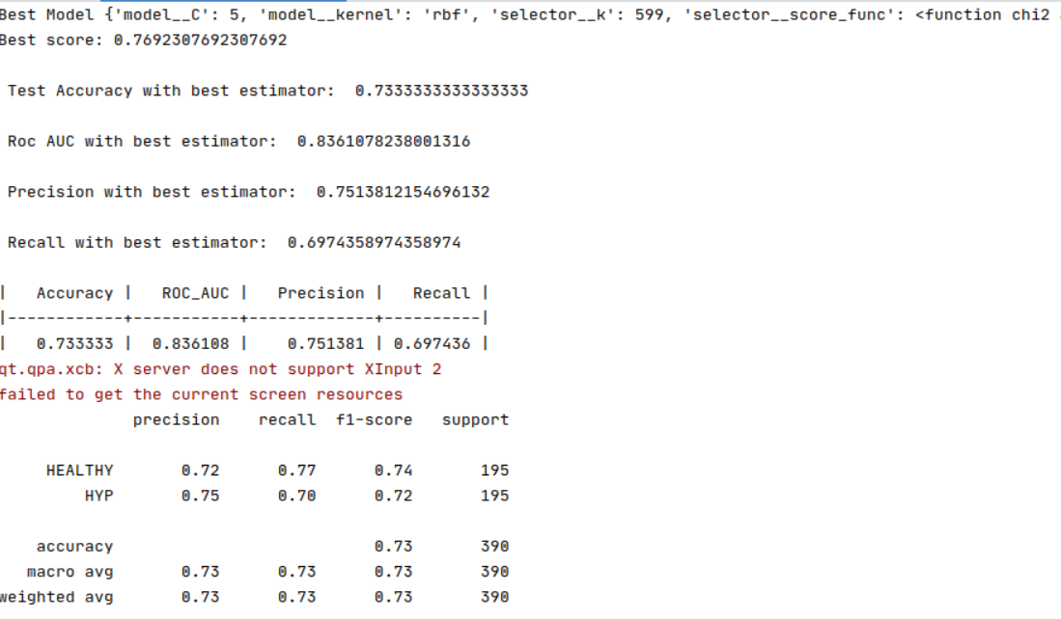
HYPE CONT

Slide 7
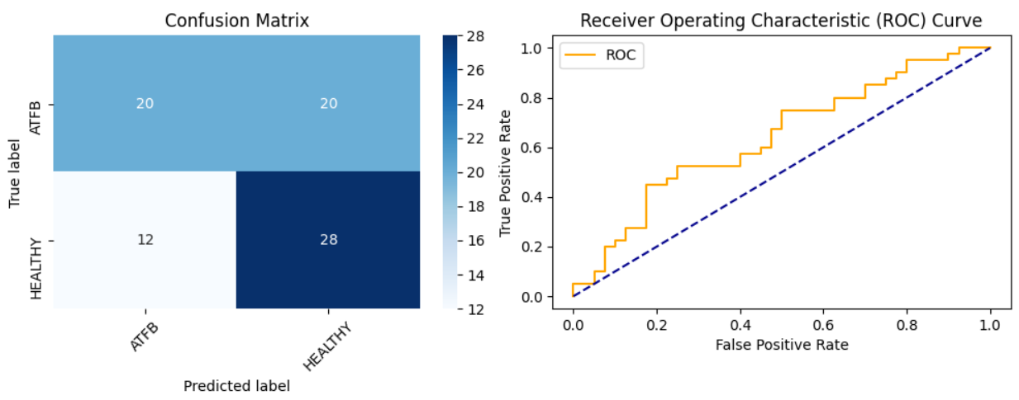
ATRIAL FIBRILIATION

Slide 8
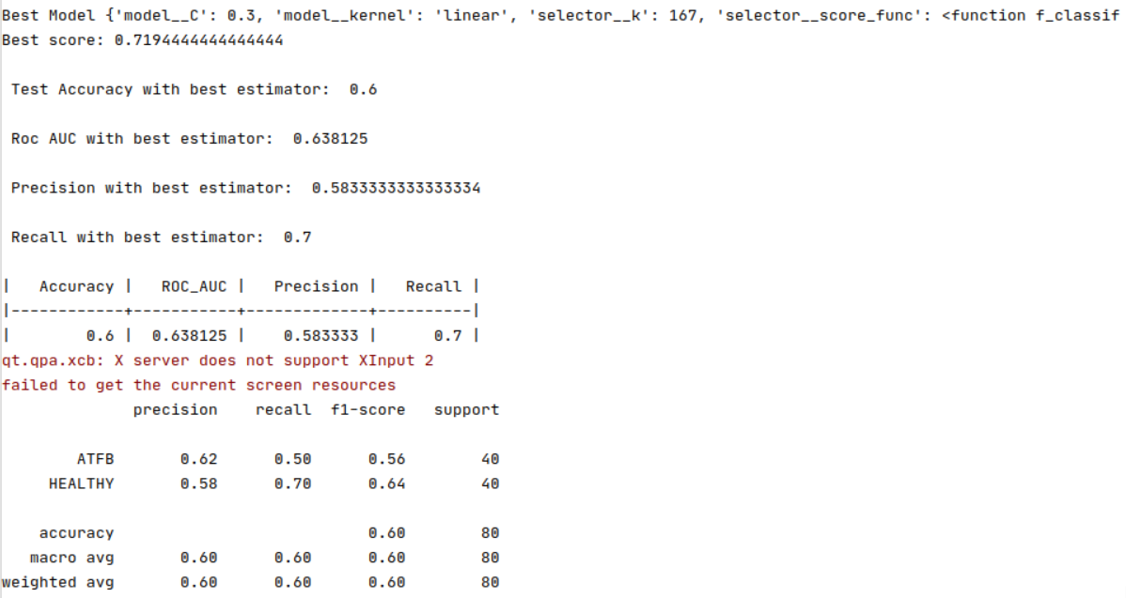
ATFB cont

Slide 9
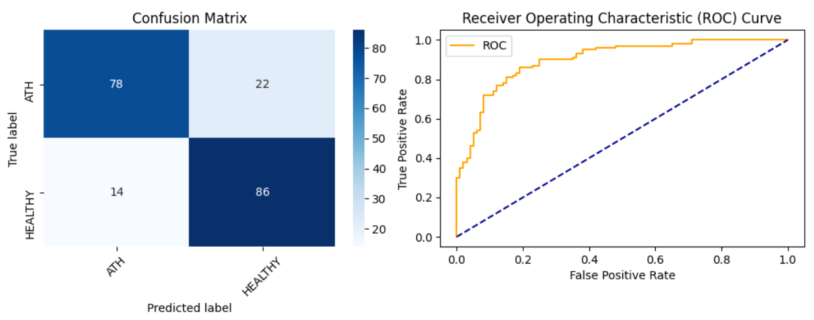
ATHEROSCLEROTIC

Slide 10
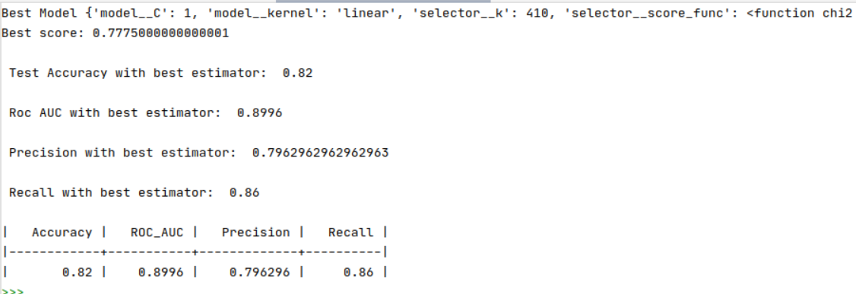
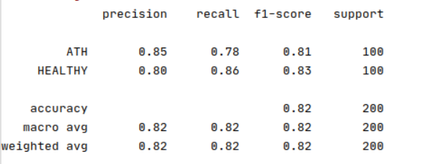
ATH Cont

Slide 11
With med info
This section was left out of the final version of the thesis.

Slide 12
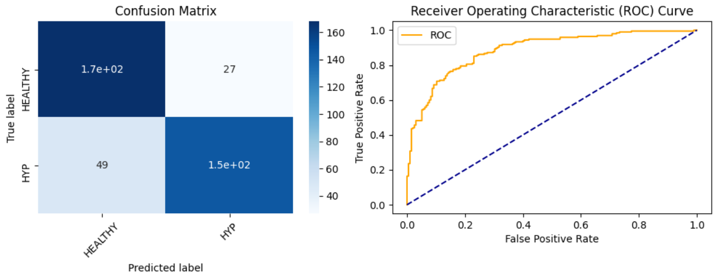
Hypertension

Slide 13
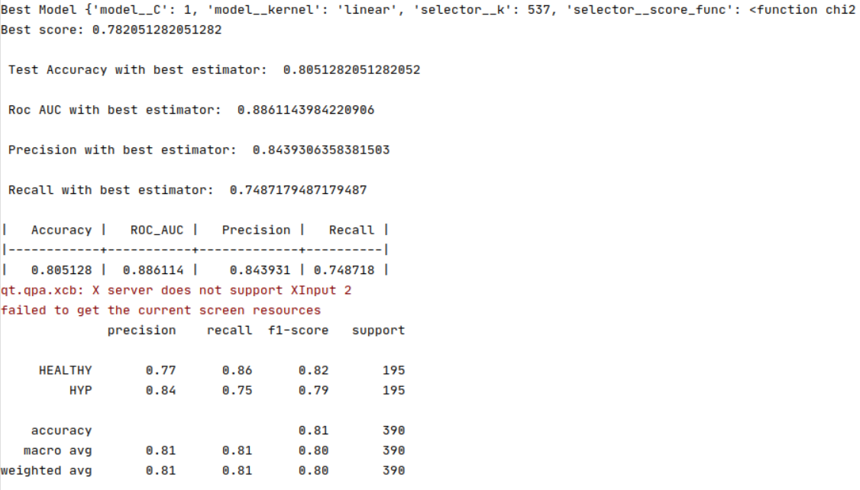
Hyp cont

Slide 14
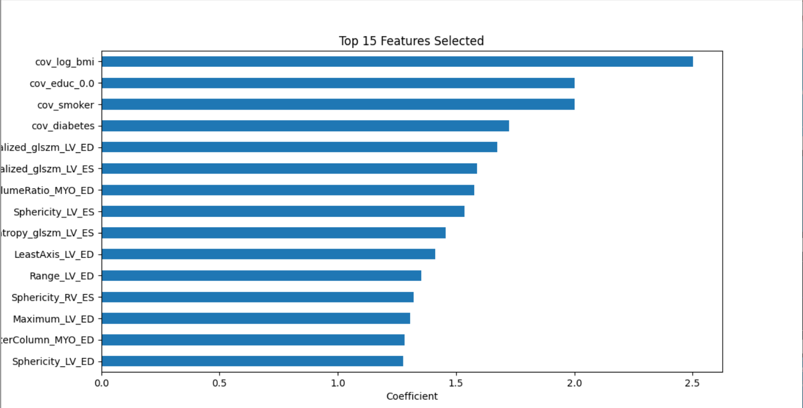

Slide 15
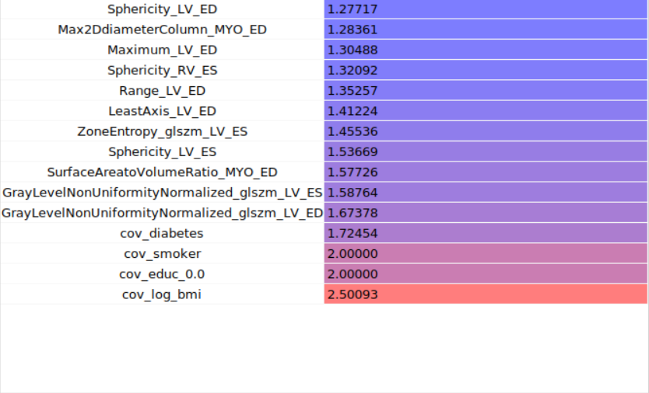

Slide 16
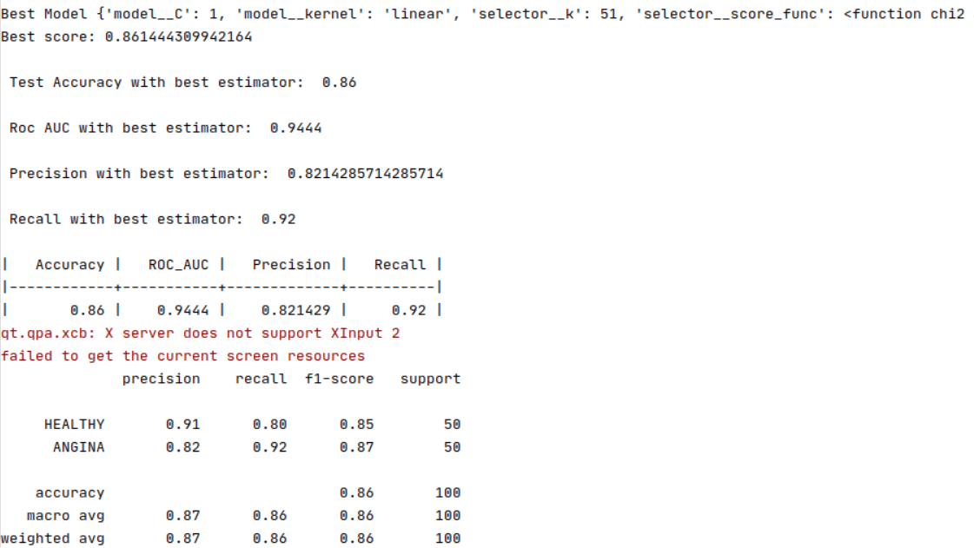
ANGINA

Slide 17
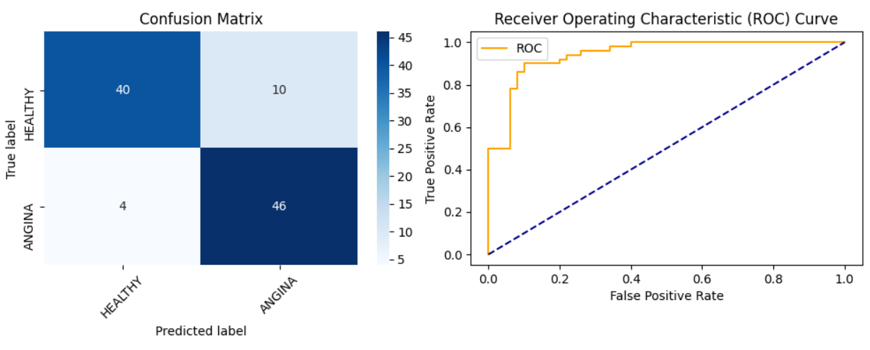
Angina cont

Slide 18
Top
Hypertension
Age
Some of MYO ES

Slide 19
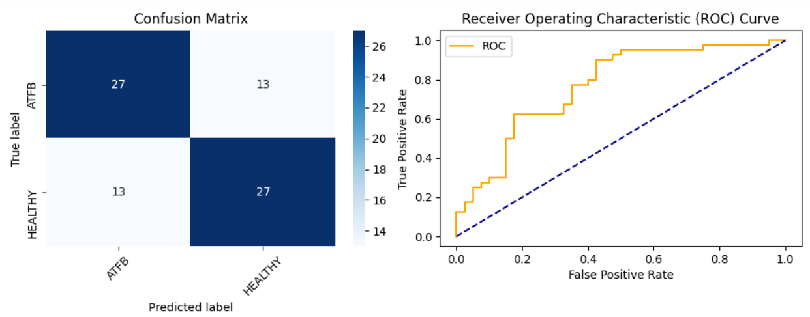
ATFB

Slide 20
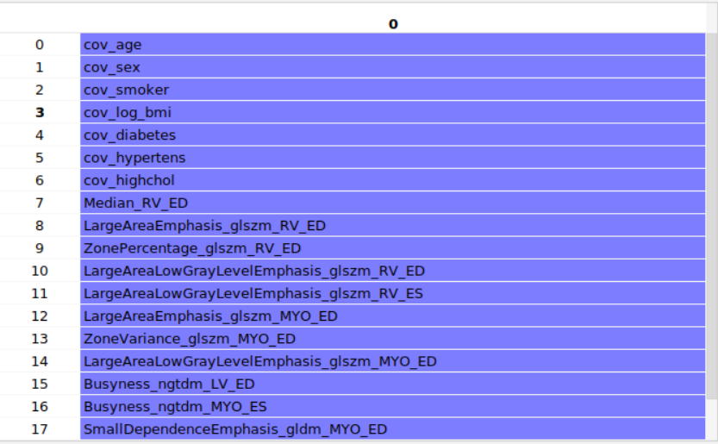

Slide 21
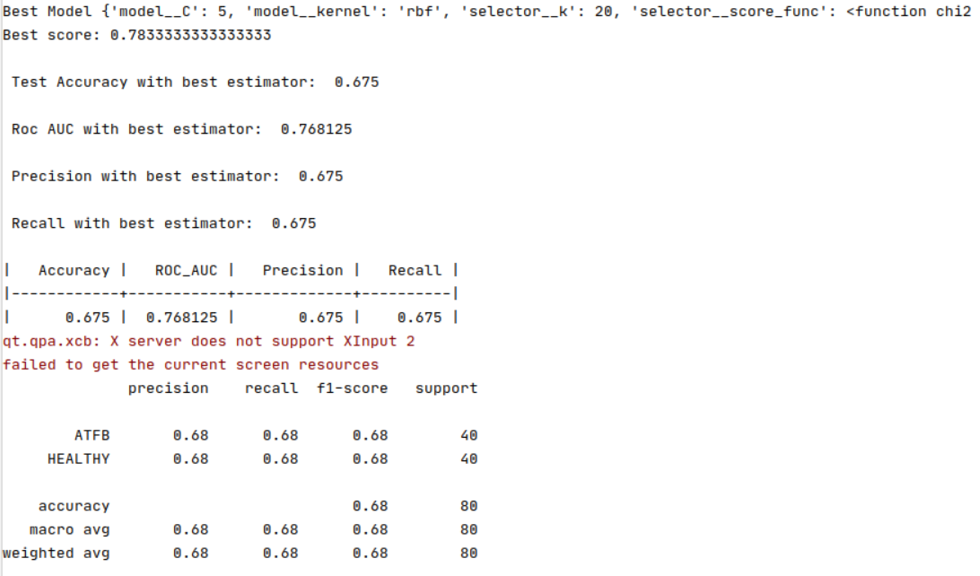

Slide 22
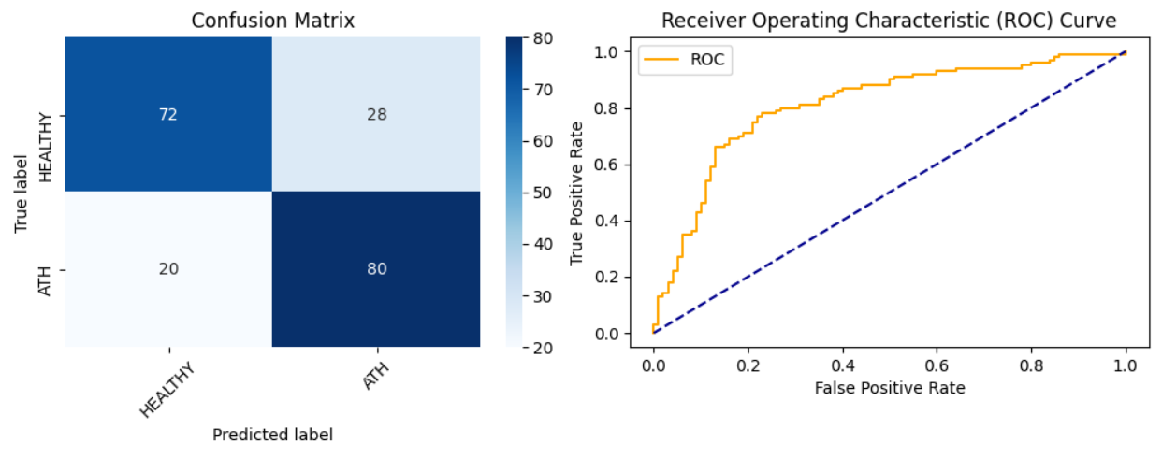
ATHEROSCLEROTIC

Slide 23
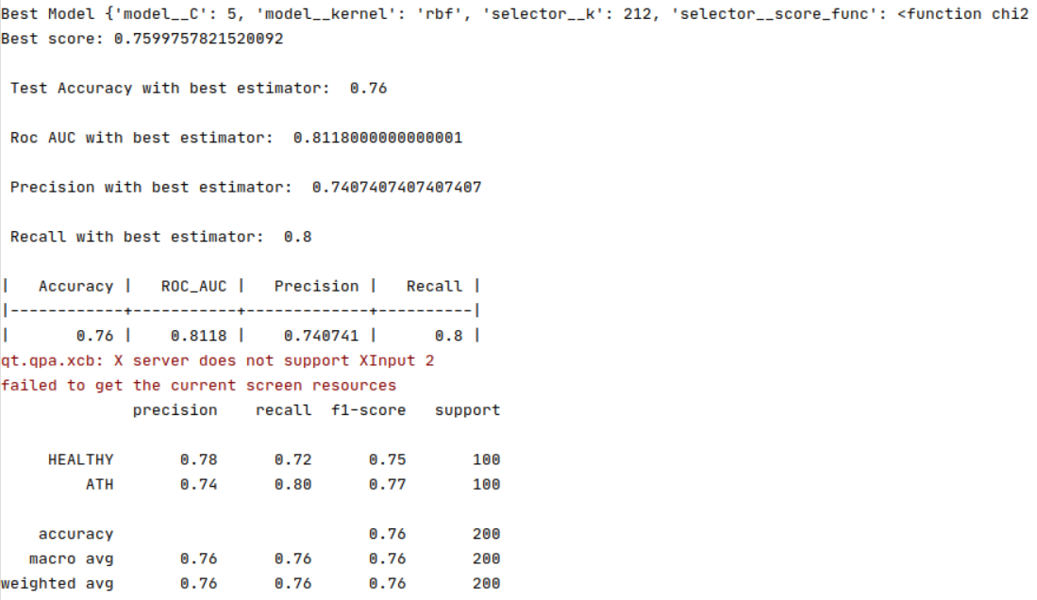

Slide 24
Fusion of Features hcr & dlr
This section comprehends the results for the fusion of features HCR + DLR

Slide 25
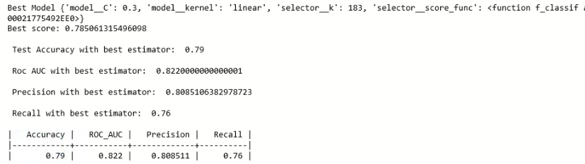
ATHEROSCLEROTIC

Slide 26
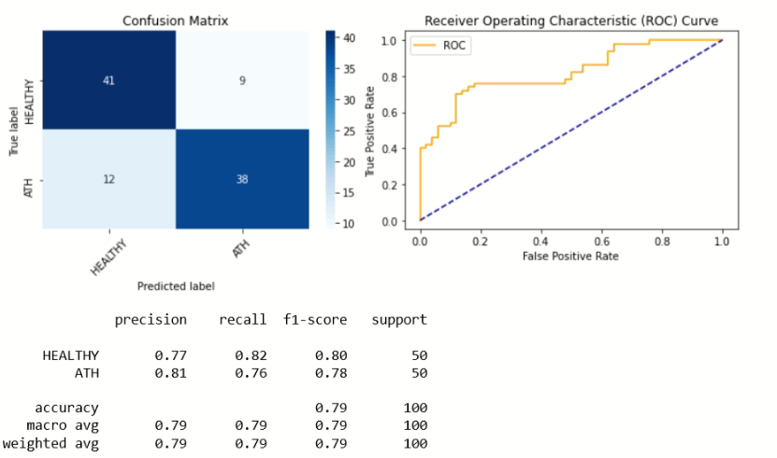
Ath cont

Slide 27
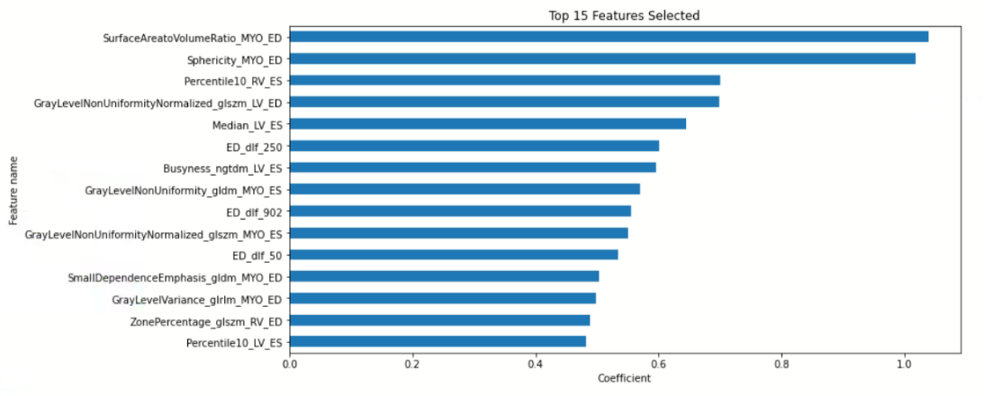

Slide 28
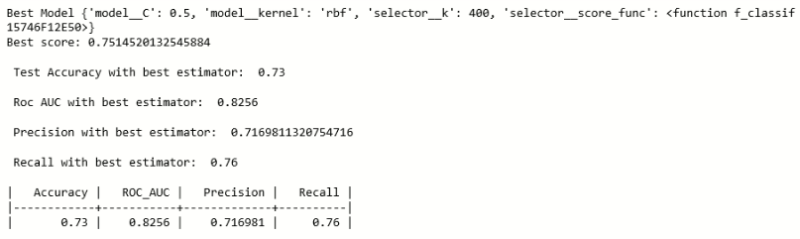
ANGINA

Slide 29
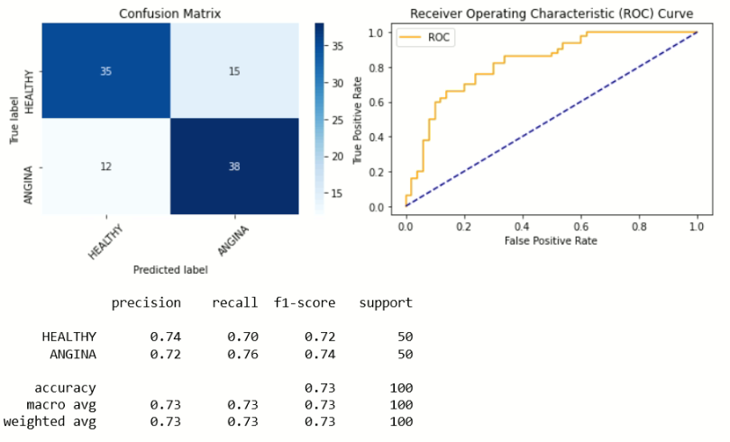
Angina cont

Slide 30
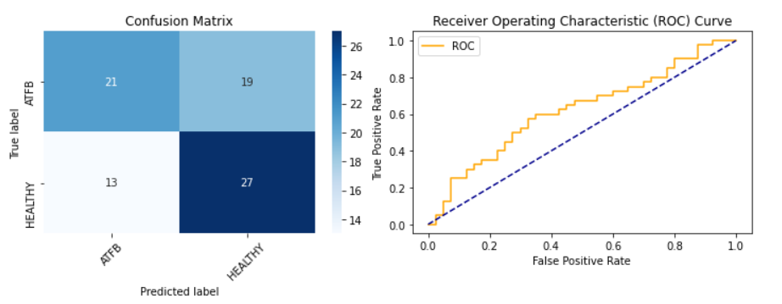
ATFB

Slide 31
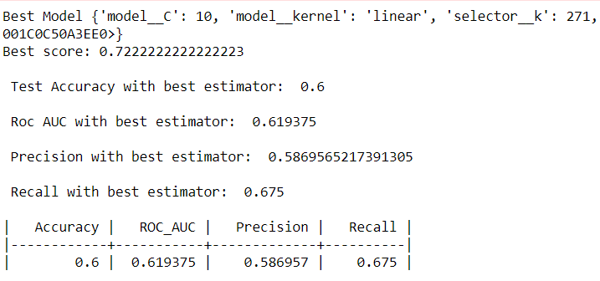
Atfb cont

Slide 32
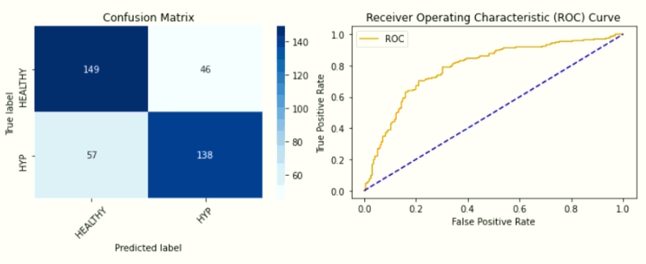
HYPERTENSION

Slide 33
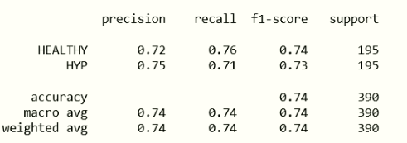
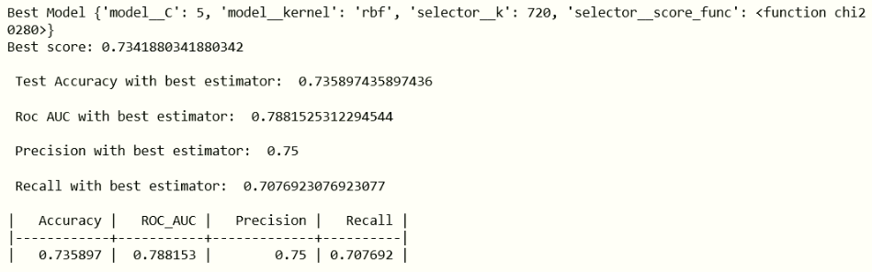

Slide 34
MED IFNO Solo
This section is some extra work where we wanted to asses the classification accuracy of only using CVRFs

Slide 35
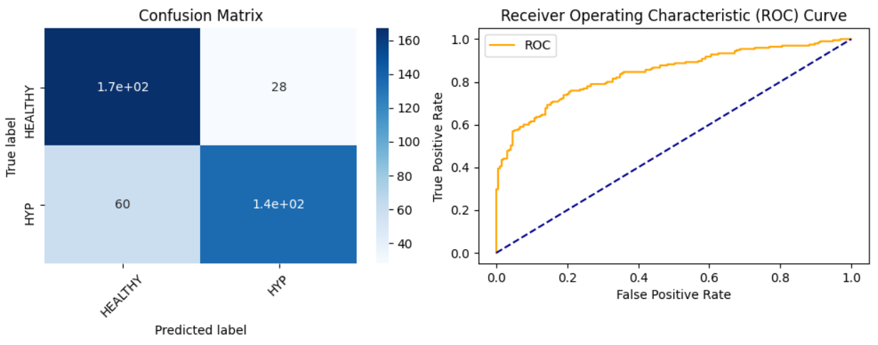
hypertension

Slide 36
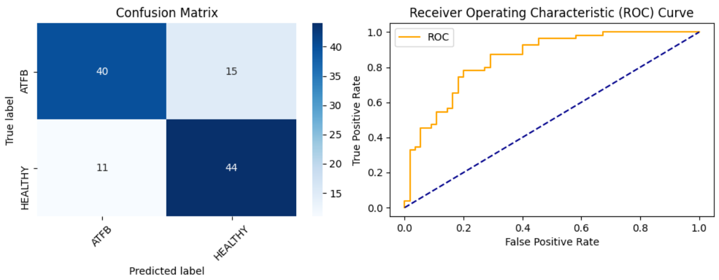
atfb

Slide 37
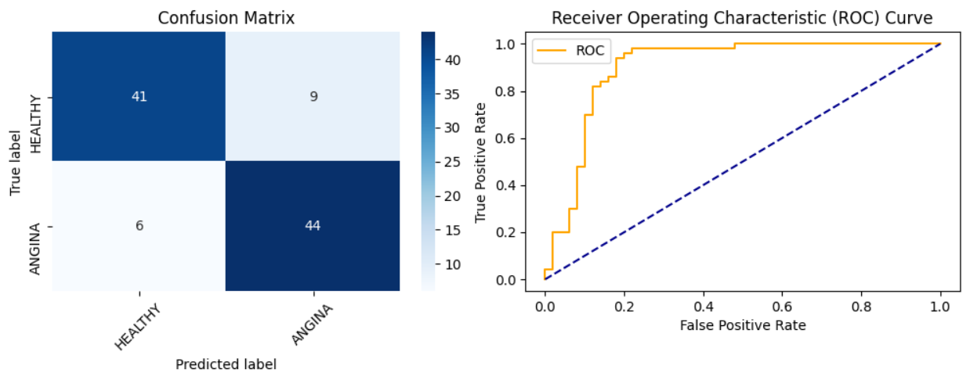
angina

Slide 38
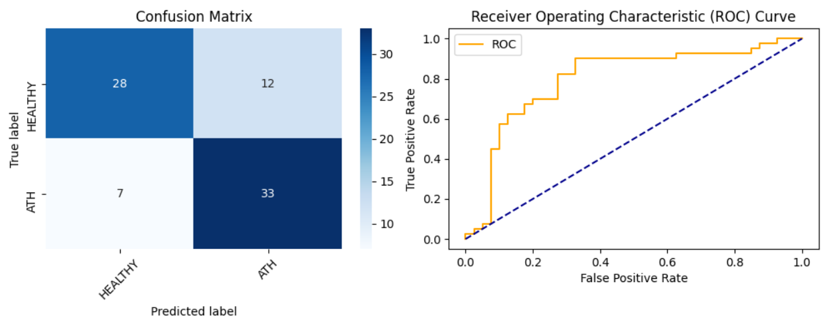
atherosclerotic

Slide 39
